Slide 1



UD 4
PROBABILITY
DISTRIBUTIONS:
discrete distrib.
1

Slide 2
Types of RANDOM VARIABLES
Nature
  QUALITATIVE
  CUANTITATIVE
Number of characteristics
  ONE-DIMENSIONAL
  K-DIMENSIONAL
Set of values
  DISCRETE
  CONTINUOUS
2

Slide 3
Types (according to the set of values):
Discrete: The sample space is formed by a finite number of values (or numerable infinite).
These values are usually the result of “counting” something:
X = number of defective pieces in a sample (finite)
X = number of throwings of a dice until obtaining for the first time 6 (numerable infinite)
X = number of readings in a diskette until it has an error (numerable infinite)
It can also be a code:
X= gender of a person E={0 (woman), 1 (man)}
X= supplier E={1 (supplier A), 2 (supplier B), 3 (supplier C)}
3

Slide 4
Continuous: They are the result of measuring or evaluating a magnitude that takes values in a continuous scale. They can take any of the infinite values possible from a finite interval (e.g. uniform variable (a, b) or infinite (e.g. Normal variable)
X= weight of a person
X= electric power consumption of a machine
X= duration of a light bulb
…
In general, values of random variables can be obtained:
discrete random variables: by counting
continuous random variables: by measuring
Probability to find a person with a height of 170 cm?
4

Slide 5
DISCRETE DISTRIBUTIONS
Example: No. of vehicles stopped in a cycle of traffic lights
Probability Function (mass function): P_{X}(x) = P(X=x) ∀x∈E
Nº v./c.
2
5
0
1
3
1
2
3
2
4
x
0
1
2
3
4
5
≥ 6
Nº data
1
2
3
2
1
1
0
P_{X}(x)
0.1
0.2
0.3
0.2
0.1
0.1
0
P(X≤x)
0.1
0.3
0.6
0.8
0.9
1
1
Σ = 10
Probability Function
Distribution Function
5

Slide 6
DISCRETE DISTRIBUTIONS
Example: No. of vehicles stopped in a cycle of traffic lights
Probability Function: P_{X}(x)=P(X=x) ∀x∈E
x
0
1
2
3
4
5
≥ 6
P_{X}(x)
0.1
0.2
0.3
0.2
0.1
0.1
0
P_{X}(x)=P(X=x)
0.3
0.2
0.1
x
0
1
2
3
4
5
6
7
6

Slide 7
Characterization of discrete variables:
PROBABILITY FUNCTION
X= sum of points obtained by throwing two dices
probabilities
D
A
D
O
1
x_{i}
P(x_{i})
1
2
3
4
5
6
2
1/36
3
2/36
D
1
2
3
4
5
6
7
4
3/36
A
2
3
4
5
6
7
8
5
4/36
D
3
4
5
6
7
8
9
6
5/36
7
6/36
O
4
5
6
7
8
9
10
8
5/36
5
6
7
8
9
10
11
9
4/36
6
7
8
9
10
11
12
10
3/36
11
2/36
12
1/36
7

Slide 8
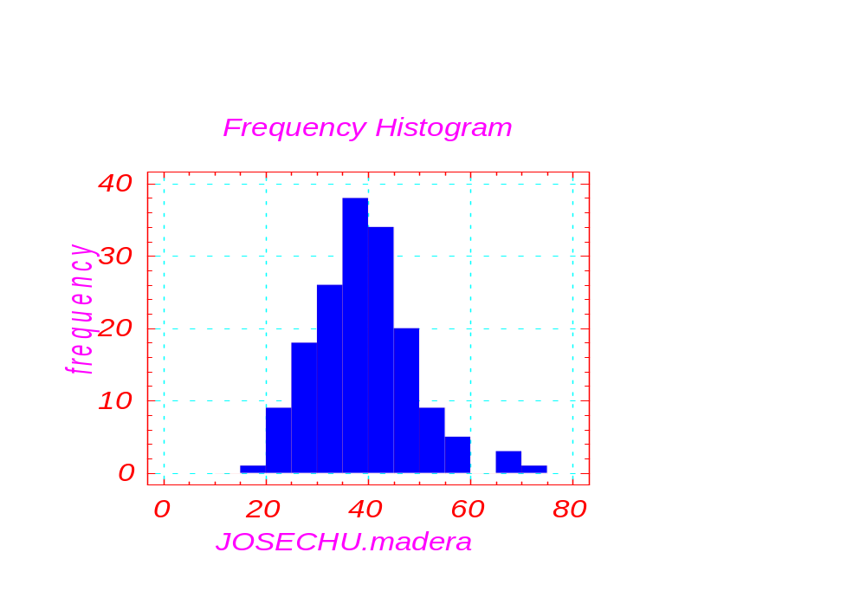

HISTOGRAMS
It is a graphical representation of one set of data (minimum 40-50 data) (frequency diagram)
8

Slide 9
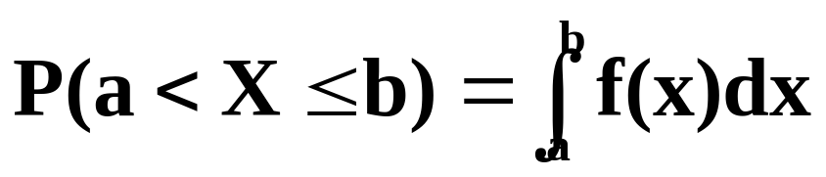
Continuous random variables: Density function
Example: length (mm) of a piece manufactured
Sample=100
0.1
0.15
0.4
0.2
0.15
mm
20
30
40
50
60
70
Dark area = 0.15
mm
30
40
Probability (30<X<40) = 0.15
Dark area = 0.15
mm
30
40
9

Slide 10
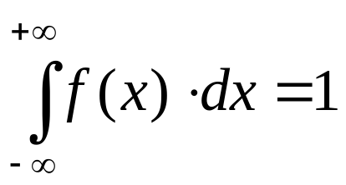
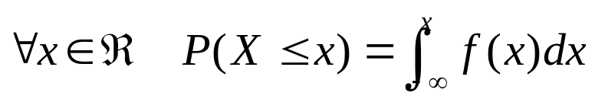
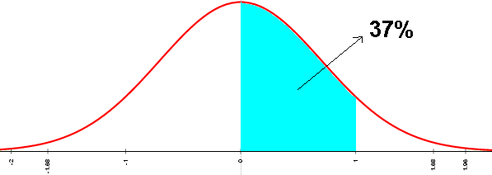
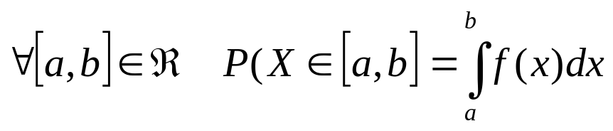
Characterization of a Continuous Variable:
DENSITY FUNCTION
Continuous variables (the probability of a certain value is zero, but not necessarily the probability within an interval)
Are characterized by means of the density function f(x) that allows calculation of probabilities in any interval
50%
Probability in an interval: area under the curve of the density function and between the limits of the interval.
P(X=x)=0 , but around that value there is a density of probability f(x), and the probability of a differential interval dx around x is: P(dx)=f(x)·dx
10

Slide 11
(2/120)(y-35) 35≤y≤41
f_{Y}(y)
f_{y}(y)=
(2/280)(55-y) 41≤y≤55
0’10
P(y₂ ≤ Y ≤ y₃)
0 y∉(35;55)
P(Y ≤ y₁)
0’05
Y= weight of packages
35
40
41
45
50
55
60
y (kg)
y₁
y₂
y₃
0,06
P(a<X<b) =
= f(x) dx
0,05
b
DENSITY FUNCTION
0,04
0,03
a
0,02
0.35
0,01
0.15
0
11
17
27
37
47
57
67
Weight (kg)

Slide 12
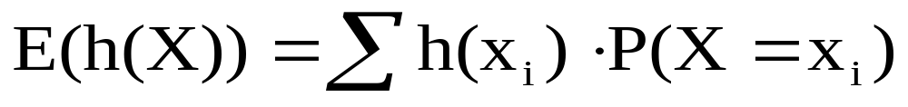
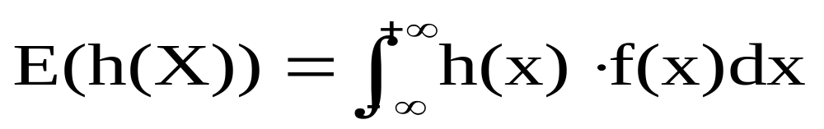
MATHEMATICAL EXPECTATION. MOMENTS:
Expectation to earn money by betting 20 € in the primitive lottery?
X RANDOM VARIABLE
h(X) FUNCTION OF X
E(h(X)) MATHEMATICAL EXPECTATION (IDEALIZATION OF ARITMETIC MEAN OR AVERAGE).
IF X IS DISCRETE:
IF X IS CONTINUOUS:
MOMENTS WITH RESPECT TO THE ORIGIN OF ORDER u OF THE RANDOM VARIABLE X : E(X^{u})
MEAN OF THE DISTRIBUTION: Average (mean) = m_{X} = E(X)
PROPERTY OF THE MEAN: E(a₀+a₁X₁+ … +a_{n}X_{n})=a₀+a₁E(X₁)+ … +a_{n}E(X_{n})
12

Slide 13
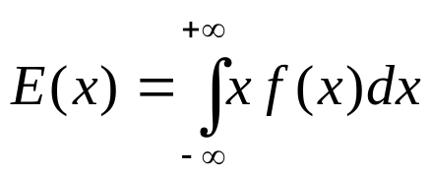
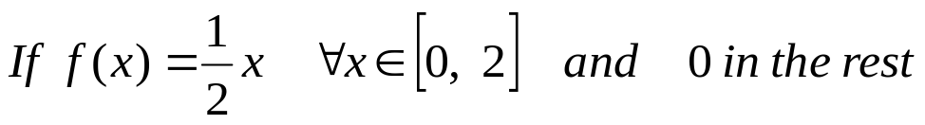
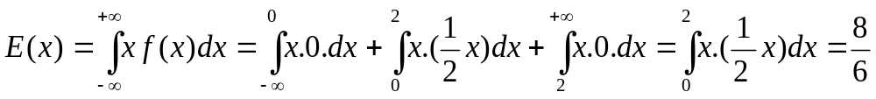
Parameters of position
Average, mean value or mathematical expectation
a) Discrete variables
If X is the number of points obtained by throwing a dice
E(x)=1· 1/6+ 2 ·1/6+ 3 ·1/6+4 ·1/6+ 5 ·1/6+ 6 ·1/6 =21/6
b) Continuous variables
Example:
13

Slide 14
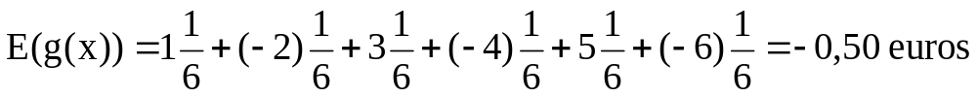
What “expectation” is there to earn money by betting 5 € to a number of roulette?
Example:
Calculate the mean amount won per play, in a game that consists of paying in each play so many euros as points obtained if the throwing of a dice is even, and receiving so many euros as points obtained if the throwing is odd. In average, how much would we win in this game?
Solution:
X= No. points by throwing the dice E=(x₁=1, x₂=2, x₃=3, x₄=4, x₅=5, x₆=6)
g(x_{i})= (+x_{i}) if i=odd, g(x_{i})=(-x_{i}) if i i=even
In average, 0.50 euros are lost per play
14

Slide 15
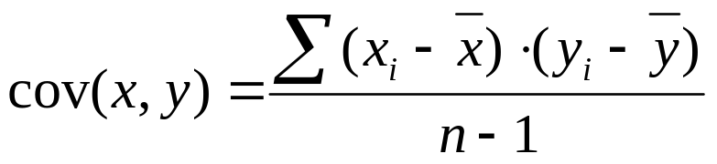
Central moments of order u of the distribution:
E(X-m)^{u}
VARIANCE OF THE DISTRIBUTION: Variance = _{X}² = E(X-m)² > 0
PROPERTIES OF THE VARIANCE (for any kind of distribution):
1.- ²(aX) = a² ²(X)
²(b+aX) = a² ²(X)
2.- IF X, Y ARE 2 COMPONENTS OF A TWO-DIMENSIONAL VAR.:
²(X ± Y) = ²(X) + ²(Y) ± 2cov(X,Y)
cov(X,Y) = _{X,Y}² = E[(X-m_{X})(Y-m_{Y})]
²(aX ± bY) = a² ²(X)+ b² ²(Y) ± 2 a b cov(X,Y)
3.- IF X, Y ARE INDEPENDENT :
²(X ± Y)=²(X)+ ²(Y)
E(X·Y)=E(X) · E(Y)
QUESTION: If X is the weight of one potato and ²(X) is the variance, what is the variance of a pack with 5 potatoes?
15

Slide 16
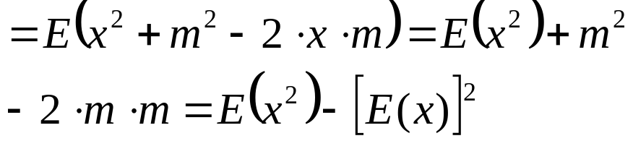
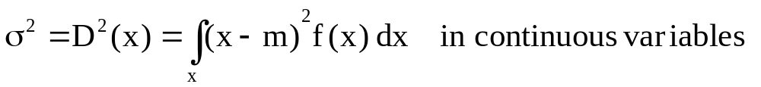
Dispersion parameters
Variance: Measure of dispersion of the variable around the average
σ² = D²(x) = E(x-m)²
Calculation:
Standard deviation:
σ=+√σ² D(x)=+√D²(x)
16

Slide 17
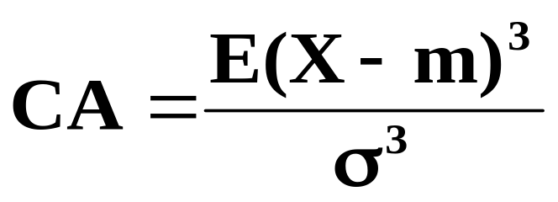

SKEWNESS COEFFICIENT OF THE DISTRIBUTION: CENTRAL MOMENT OF ORDER 3.
KURTOSIS COEFFICIENT OF THE DISTRIBUTION: CENTRAL MOMENT OF ORDER 4
17

Slide 18

DISCRETE
DISTRIBUTIONS
18

Slide 19
BINOMIAL DISTRIBUTION
- A: EVENT OF PROBABILITY P ASSOCIATED TO A
CERTAIN RANDOM EXPERIMENT.
A={obtain a “4”} P=P(A)= 1/6
- WE CARRY OUT n INDEPENDENT REPETITIONS OF THE
EXPERIMENT.
n=5
- RANDOM VARIABLE X: NUMBER OF TIMES THAT EVENT A
OCCURS (0, 1, 2 ,3, … , n).
Number of times that we obtain 4 after throwing 5 dices
X FOLLOWS A BINOMIAL DISTRIBUTION THAT DEPENDS ON TWO PARAMETERS: n AND P. X ∼ B (n,P)
X∼B(5, 1/6)
19

Slide 20

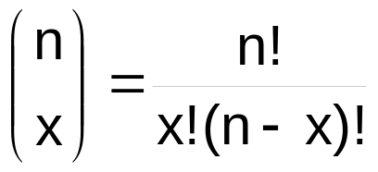
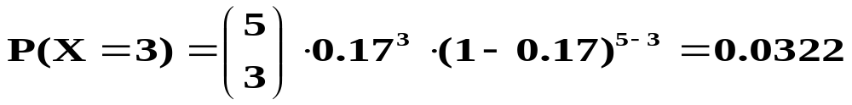
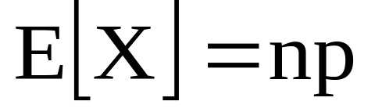
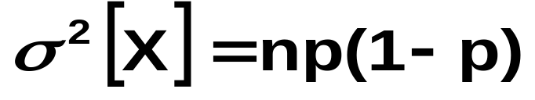
PROBABILITY FUNCTION OF X IS:
P(X=x) =
P^{X}(1-P)^{n-x}
20

Slide 21
Prob. Mass Fcn.
n=6 p= 0.1
Binomial
Prob. Mass Fcn.
n=10 p=0.2
Binomial
0.6
0.4
0.5
0.4
0.3
prob. mass
prob. mass
0.3
0.2
0.2
0.1
0.1
0
0
0
1
2
3
4
5
6
0
2
4
6
8
10
X
X
Prob. Mass Fcn.
n=40 p=0.2
Binomial
0.16
0.12
prob. mass
0.08
0.04
0
21
0
10
20
30
40
X

Slide 22
PROBLEM:
Probability to obtain at least one 5 in six consecutive throwings of a dice.
22

Slide 23
PROBLEM:
One hunter has a probability of 40% to hit the target. What is the probability to hit the target with 3 shots (or less)?
23

Slide 24
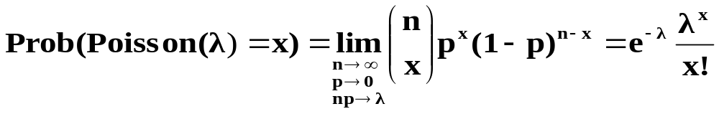
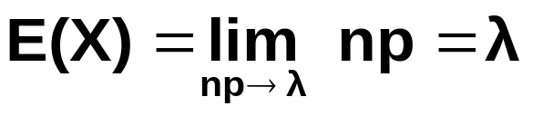
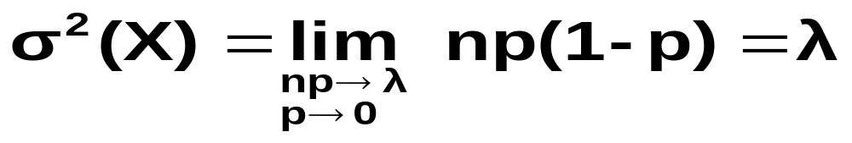
POISSON DISTRIBUTION
The Poisson distribution is the limit of a Binomial distribution when:
- n → ∞ , p → 0
- and the product n·p tends to a constant λ
The probability function of a Poisson distribution of parameter λ is:
AVERAGE OF THE DISTRIBUTION:
VARIANCE :
24

Slide 25
Poisson distributions are useful when we measure the number of occurrences of an event in a certain time or space.
X_{i} ~ Ps(λ_{i}) ; Y = Σ X_{i} (independent) Y ~ Ps (λ = Σ λ_{i})
EXAMPLES:
- Number of accidents per weekend
- No. of cars passing per min. through a bridge
- Number of errors in a printed page of book
- Number of errors in a program code
25

Slide 26
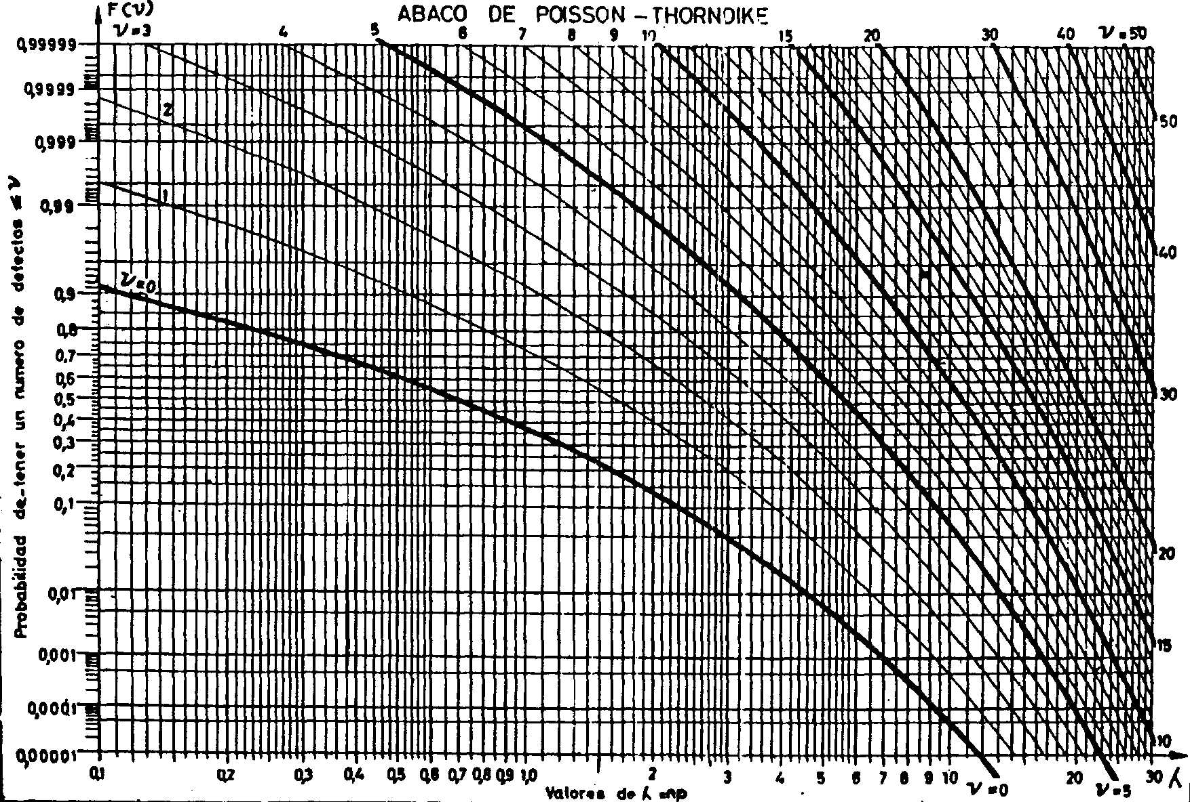
ABAC OF POISSON
CALCULATES P(X ≤ c) BEING X ∼ POISSON (λ)
26

Slide 27
PROBLEMS
It is known that there are in average 3 mortal accidents per day in Spanish roads (excluding weekends).
a) What is the probability of occurring no mortal accidents next Tuesday?
b) What is the probability of occurring more than 7 mortal accidents
next Tuesday?
Assuming that accidents in the different days of the week are independent and that the average number of mortal accidents in the weekend (Saturday and Sunday) is 15,
c) what is the probability of occurring less than 25 mortal accidents next week?
d) what is this probability, knowing that 8 mortal accidents have already occurred during the first two days?
27

Slide 28


UD 4 - part 2
CONTINUOUS DISTRIBUTIONS:
uniform, exponential
28

Slide 29
PROBLEM:
One train leaves from a station every 20 minutes. One traveler arrives at the station to take the train.
Variable X: waiting time (time between the traveler arrives and the train departure).
a) What is the minimum, maximum of X?
b) Draw a histogram for the values of X.
c) Calculate the density function of X.
d) What is the average and median of X?
e) P(X<7)
f) P(X=7)
29

Slide 30
0 x ≤ 0
K
f_{X}(x)=
1/20 x ∈ (0,20)
0 x ≥ 20
0
20
x
PROBLEM:
I have a file called "exercises.doc" in my laptop, but I cannot find it. I carry out a search and write down the time taken by the computer to find the file. If this operation is repeated many times, what would be the distribution of this variable?
30

Slide 31
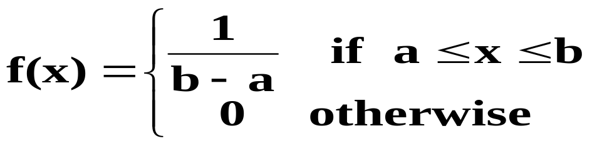
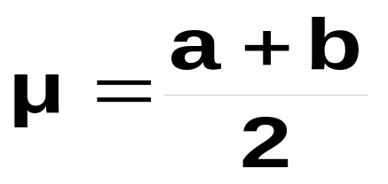
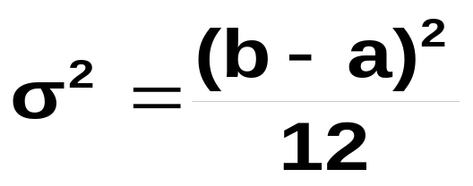
UNIFORM DISTRIBUTION
One random variable is UNIFORM U(a,b) if the density function is constant.
1/(b-a)
a
b
AVERAGE :
VARIANCE:
31

Slide 32
PROBLEM:
Every time that there is an accident in a factory, they record X: time passed since the last accident. The average of X is 15 days.
a) What is the minimum, maximum of X?
b) Draw a histogram for the values of X.
c) How would be the density function?
d) P(X=15)
e) P(X<15)
32

Slide 33
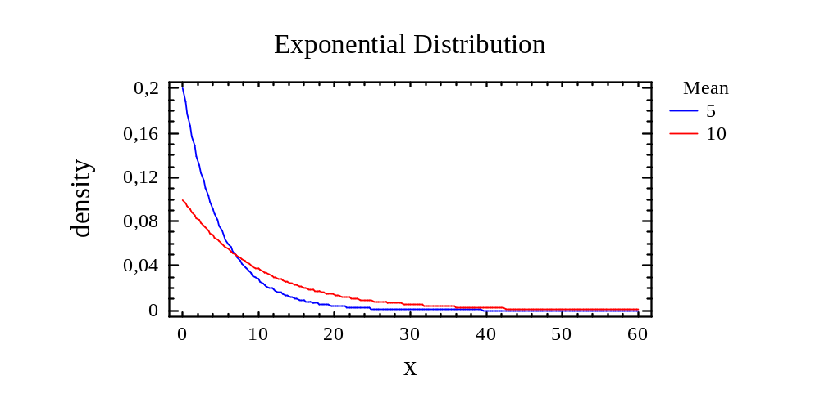
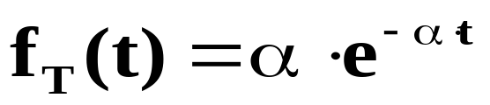
EXPONENTIAL DISTRIBUTION
Time until a Poisson event (accident, failure...)
X: time of operation of a light bulb until breakdown
X: time of operation of a computer until failure
Time between two Poisson events:
X: time between two consecutive failures of a printer
X: time between two accidents in a factory
In a shop: time of waiting until being attended
λ=0.2
λ=0.1
33

Slide 34
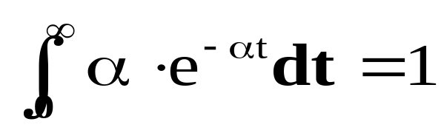
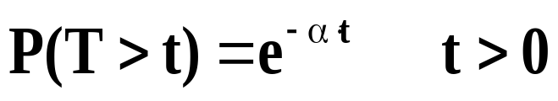
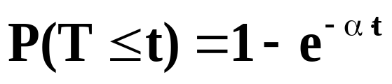
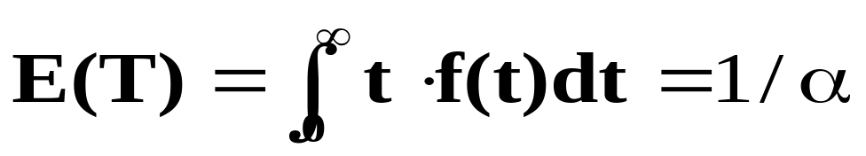
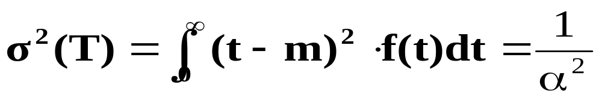
T follows an exponential distribution of parameter α
DENSITY
FUNCTION:
AVERAGE:
VARIANCE:
Observed values of time follow an exponential distribution if their average and standard deviation are similar.
34

Slide 35
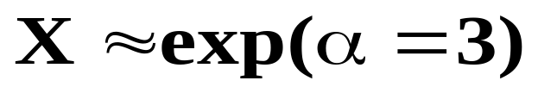
EXERCISE: Calculate the median of the distribution:
“The reliability of this TV is 80% at 2000 hours”, means...
P (time until failure > 2000) = 0.8
True
P (time until failure < 2000) = 0.8
False
35

Slide 36
PROBLEM:
One car arrives at a crossroad and stops. At that time, the average number of vehicles passing per minute through the main road is 10. The driver needs 10 seconds without cars passing through to make the incorporation into the main road.
STOP
CALCULATE
a) Probability of passing more than one car in 3 min.
var. X: number of cars passing through in 3 min.
36

Slide 37
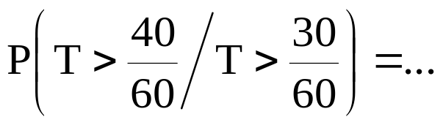
b) What is the distribution of the following variable?
var. T: time since the car stops at the crossroad until the first vehicle passes through.
c) If we know that 30 seconds ago passed the last vehicle, what is the probability of not having to wait when arriving to the crossroad?
37

Slide 38
If T : exp(α)
The probability of a TV to work > 30 years knowing that has not failed in 29 years =
= probability to work > 1 year
P(T>30 / T>29) = P(T>1)
If failures of a machine are more likely as it ages (which often occurs), time until failure will not follow an exponential distribution.
If time until failures follows an exponential distribution it implies that failures are due to accidental causes and not to aging.
38

Slide 39
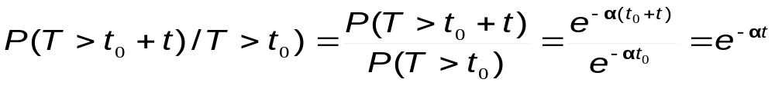
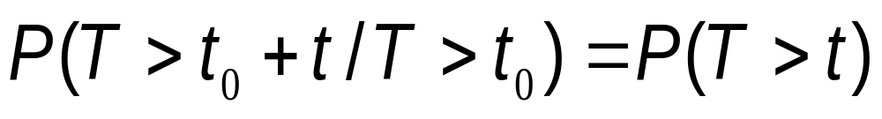
LACK OF MEMORY PROPETY:
THE FUTURE PERFORMANCE IS INDEPENDENT OF THE PAST PERFORMANCE:
Therefore:
39

Slide 40
UD 4 - part 3
CONTINUOUS DISTRIBUTIONS:
NORMAL distrib.
40

Slide 41
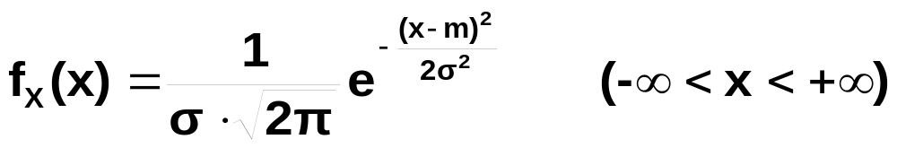
NORMAL DISTRIBUTION
Describes properly many continuous variables found in practice: most variables with a symmetric distribution
Density function
m
Typical histogram of a Normal distribution
X ∼ N ( m , σ )
E(X) = m
σ (X) = σ
41

Slide 42
PROPERTY OF ANY DISTRIBUTION:
If X and Y are two components of a two-dimensional random variable:
²(a·X ± b·Y) = a²·²(X) + b²· ²(Y) ± 2 a b cov(X,Y)
PROPERTIES OF THE NORMAL DISTRIBUTION:
1) If X ∼ N(m_{x} , σ_{x} )
Y = a + bX ∼ N (m_{y}= a + b m_{x} , σ_{y}² = b² σ_{x}²)
2) If X ∼ N(m_{x} , σ_{x} ) and Y ∼ N(m_{y} , σ_{y} ) independent
+
+
Z = X Y ∼ N (m_{z} = m_{x} m_{y} , σ_{z}² = σ_{x}² + σ_{y}² )
-
-
42

Slide 43







percentile 15.865
84.135
31.73%
68.27%
P(m-σ < X < m+σ) = 0.6827
percentile 2.275
97.725
4.55%
95.45%
P(m-2σ < X < m+2σ) = 0.9545
0.135
99.865
0.27%
99.73%
P(m-3σ < X < m+3σ) = 0.9973
43

Slide 44
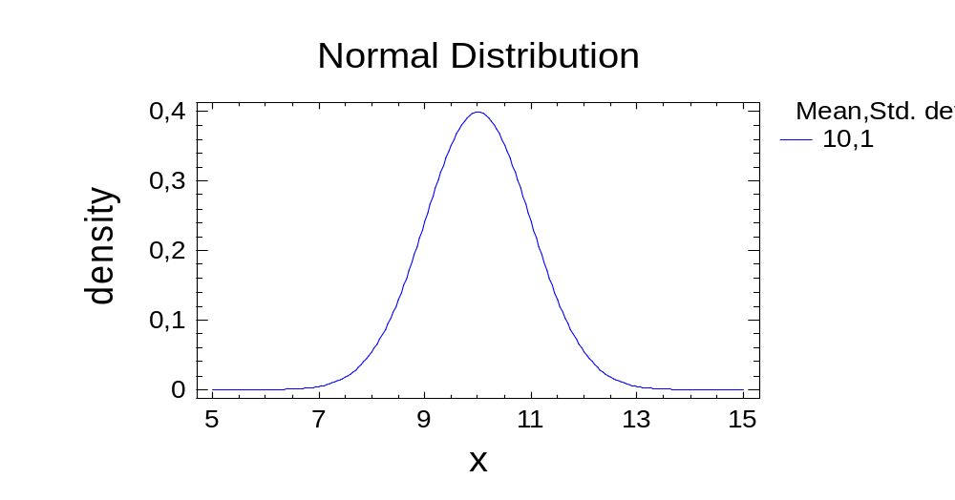
DENSITY FUNCTION of N (m,σ)= N(10,1)
44

Slide 45
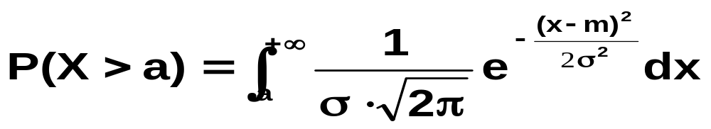
How to calculate P ( X ∼ N(m_{x} , σ_{x}) > a) ?
m
a
Cannot be solved analytically use table
P(X>a) P(X>a) because P(X=a) =0
45

Slide 46
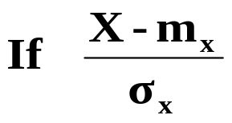
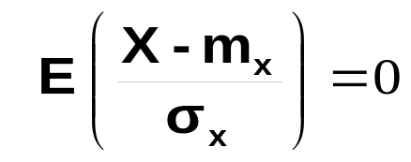
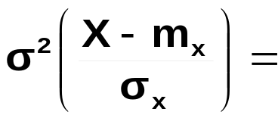
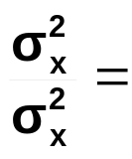

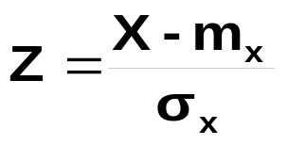

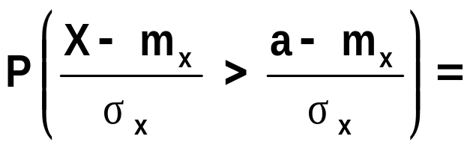
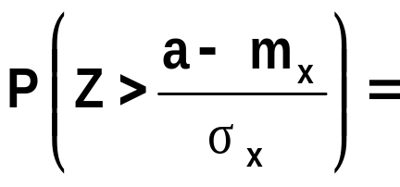
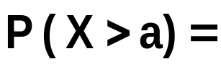

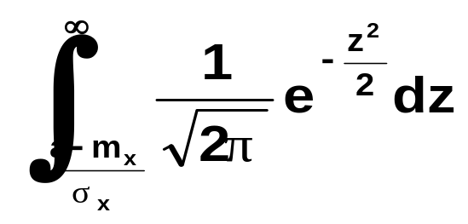
If X - m_{x}
E(X - m_{x}) =
E(X) - m_{x} =
0
∼
STANDARD NORMAL DISTRIBUTION
Cannot be solved analytically
Solved by numeric methods
Table N(0,1)
46

Slide 47

STANDARD NORMAL DISTRIBUTION
The variable N(0,1) is sometimes called Z
Critical value z_{α} :
P[N(0, 1) > z_{α} ] = α
α
z_{α}
47

Slide 48



STANDARD NORMAL DISTRIBUTION
α
z
-z

Slide 49
USE OF THE N(0, 1) TABLE
Z = Normal (0,1)
Z = 0
Z < 0
Z > 0
Negative!
z1
z2
Positive!
P(Z≤ 0) = 0,5
P(Z≤ z1) = 0,3
P(Z≤ z2) = 0,7
49

Slide 50
Normal (0,1)
P (a < N(0,1) < b) = P (N(0,1) < b) - P (N(0,1) < a)
P (a < N(0,1) < b)
0
a
b
P (N(0,1) < b)
a
b
P (N(0,1) < a)
50
a
b

Slide 51
1
F_{R}(x)=P(Rx)
P(a<X<b) = F(b) - F(a)
0,8
0,6
DISTRIBUTION FUNCTION
F(x)
0,4
0.35
0,2
0
17
27
37
47
57
67
a b
Weight (kg)
0,06
0,05
P(a<X<b) =
= f(x) dx
DENSITY FUNCTION
f(x)
f(x)=dF(x)/dx
0,04
b
0,03
a
0.35
0,02
0,01
0.15
0
17
27
37
47
57
67
51
Weight

Slide 52
NORMAL PROBABILITY PLOT:
X ∼ N (m,σ)
P = P(X≤a)
P(X≤a)
P
P (%)
a
100
99.9
P(X≤a)
99
95
80
50
50
20
5
1
0
0.1
a
a
Values of x
Values of x
Plot with ordinary scale
Normal probability plot
52

Slide 53

CONSTRUCTION OF A NORMAL PROBABILITY PLOT:
Resistance of 10 metallic pieces:
14.1 13.1 12.5 15.6 14.6 15 17 13.5 16.3 11.8 (Nw)
1) Sort the data from the lowest to the highest (increasing order)
i (order) 1 2 3 4 5 6 7 8 9 10
11.8 12.5 13.1 13.5 14.1 14.6 15 15.6 16.3 17
P(X≤x) (%) 5% 15% 25% 35% 45% 55% 65% 75% 85% 95%
2) Obtain the cumulated probabilities:
3) Plot the values of X and P(X≤x) in the Normal Probability Plot
53

Slide 54
Normal Probability Plot
99.9
99
95
84.13%
80
cumulative percent
50
20
15.87%
5
1
m-σ=12.5
m+σ=16.3
0.1
11
12
13
14
15
16
17
Median=mean=14.4
σ=1.9
σ=1.9
11.8 5%
12.5 15%
13.1 25%
13.5 35%
14.1 45%
14.6 55%
15 65%
15.6 75%
16.3 85%
17 95%
Data follow approx. a straight line
X: resistance ∼ N(m_{x},σ_{x})
How to estimate m_{x}?
How to estimate σ _{x}?
Therefore, X ∼ N( m_{x}=14.4 , σ _{x}=1.9 )
54

Slide 55
Normal Probability Plot
Normal Probability Plot
99.9
99.9
99
99
95
95
80
80
cumulative percent
50
cumulative percent
50
20
20
5
5
1
1
0.1
0.1
0
20
40
60
80
100
36
46
56
66
76
86
96
TIME
N(50,5) + N(70,5)
Normal Probability Plot
Positive skew
99.9
Mixture of 2 populations
99
95
80
cumulative percent
50
20
5
1
0.1
Abnormal datum
150
160
170
180
190
55
ESTATURA SELECT SEXO EQ 2

Slide 56
NORMAL APPROXIMATIONS
CENTRAL LIMIT THEOREM
Under very general conditions, the addition of independent random variables, whatever type of distribution, tends to a normal distribution as the number of addends increases.
This theorem justifies why most distributions of continuous variables found in real problems are Normal.
56

Slide 57
PROBLEM:
The resistance of an elevator in a factory is 10,000 kg. This elevator is used to carry packages with weight fluctuating uniformly between 40 and 60 kg. Calculate the maximum number of packages that can be loaded so that the probability to exceed the maximum load is lower than 0.1%.
Solution: n_{max}=195
57

Slide 58

APROXIMATION OF A BINOMIAL VARIABLE BY MEANS OF A NORMAL DISTRIBUTION
If X ∼ Binomial (n,p) => E(X) = n·p ; σ²(X) = n·p·(1-p)
X = Y₁+Y₂+…+ Y_{n} ; Y_{i} ∼ Bernouilli (p) independient
If n is high: X ~ N [ m = n·p , σ² = n·p·(1-p) ]
The approximation is good if:
X ∼ Binomial (n,p) --> if n>50 and p<0.1 --> X ∼ Ps (n·p)
58

Slide 59
Prob. Mass Fcn.
n=6 p= 0.1
Binomial
Prob. Mass Fcn.
n=10 p=0.2
Binomial
0.6
0.4
0.5
0.4
0.3
prob. mass
prob. mass
0.3
0.2
0.2
0.1
0.1
0
0
0
1
2
3
4
5
6
0
2
4
6
8
10
X
X
Prob. Mass Fcn.
n=40 p=0.5
Binomial
0.15
0.12
0.09
prob. mass
0.06
0.03
0
0
10
20
30
40
59
X

Slide 60
PROBLEM:
Assuming that the probability to say an odd digit (1, 3, 5, 7, 9) or an even digit (0, 2, 4, 6, 8) is the same, calculate approximately the probability that, among 131 digits randomly chosen by students, 88 or more are odd.
sample
2 cases (odd or even)
SAMPLE
Event A (88 individuals out of 131 chose an odd number)
( 67.2% )
Extrapolation
What can we say about P at the population level?
POPULATION
60

Slide 61


APROXIMATION OF A POISSON VARIABLE
BY MEANS OF A NORMAL DISTRIBUTION
If X ∼ Poisson (λ)
X ~ N [ m = λ , σ² = λ ]
Follows approximately
a N(0,1) distribution
The approximation is good if:
PROBLEM:
One consulting service receives in average 2 calls per minute. Calculate approximately the probability to receive more than 150 calls in one hour.
61

Slide 62
Prob. Mass Fcn.
λ=0.7
Prob. Mass Fcn.
λ=2.5
Poisson
Poisson
0.5
0.3
0.4
0.25
0.3
0.2
prob. mass
prob. mass
0.15
0.2
0.1
0.1
0.05
0
0
0
2
4
6
8
10
0
2
4
6
8
10
12
X
X
Prob. Mass Fcn.
λ=10
Poisson
0.15
0.12
0.09
prob. mass
0.06
0.03
0
0
5
10
15
20
25
30
62
X

Slide 63
CORRECTION OF CONTINUITY
P[ Ps(λ=36) < 3 ] = P [ N (36, 6) < 2.5 ]
P[ Ps(λ=36) < 3 ] = P [ N (36, 6) < 3.5 ]
P[ Ps(λ=36) = 3 ] = P [N (36, 6) < 3.5] - P [N (36, 6) < 2.5]
63

